Slide 1
VERIFIED after this

Slide 2
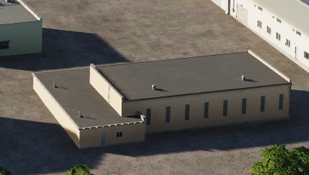
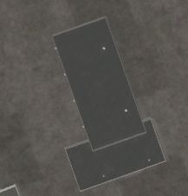
 | 500 IBS | 1000 IBS | 2000 IBS
1x Bomb
2x Bombs
4x Bombs
Gives ruins

Slide 3
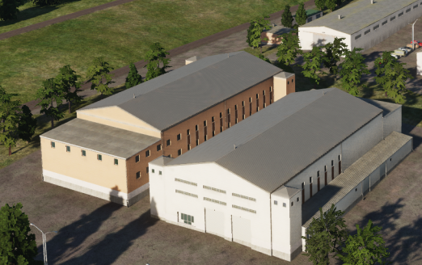
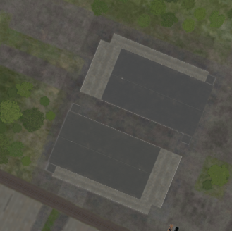
Same building, just different colors
 | 500 IBS | 1000 IBS | 2000 IBS
1x Bomb
2x Bombs
4x Bombs
Gives ruins

Slide 4
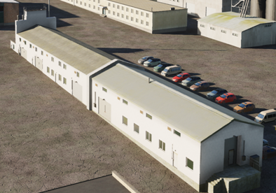
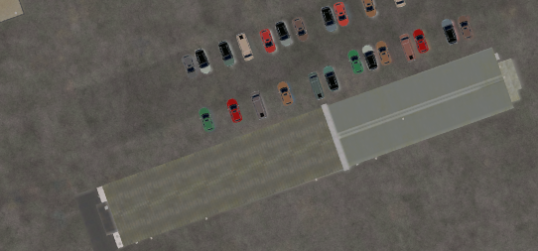
 | 500 IBS | 1000 IBS | 2000 IBS
1x Bomb
2x Bombs
4x Bombs
Gives ruins

Slide 5
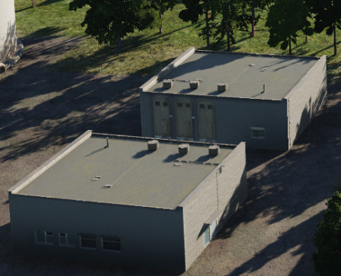
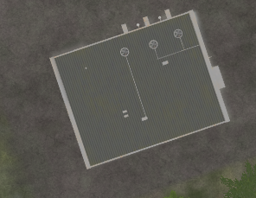
 | 500 IBS | 1000 IBS | 2000 IBS
1x Bomb
2x Bombs
4x Bombs
Gives ruins

Slide 6
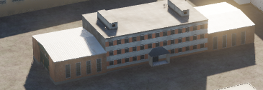
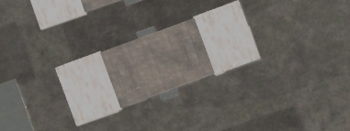
 | 500 IBS | 1000 IBS | 2000 IBS
1x Bomb
2x Bombs
4x Bombs
Gives ruins

Slide 7
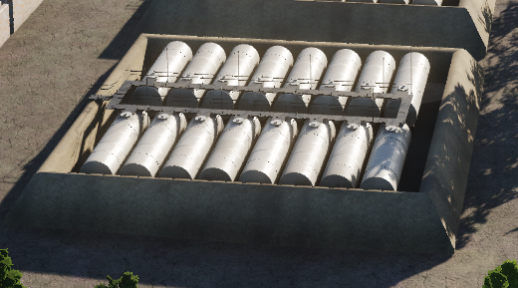
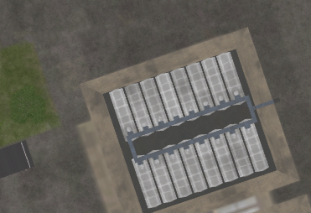
 | 500 IBS | 1000 IBS | 2000 IBS
1x Bomb
2x Bombs
4x Bombs
Gives ruins

Slide 8
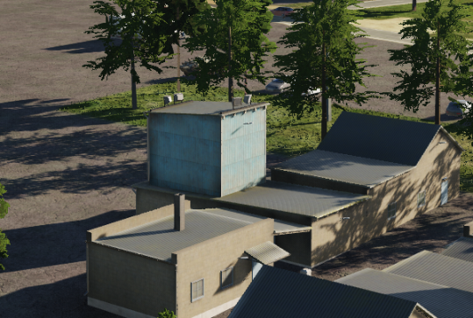
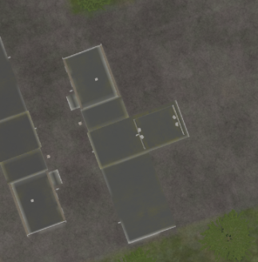
 | 500 IBS | 1000 IBS | 2000 IBS
1x Bomb
2x Bombs
4x Bombs
Gives ruins

Slide 9
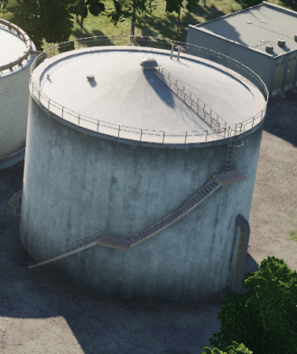
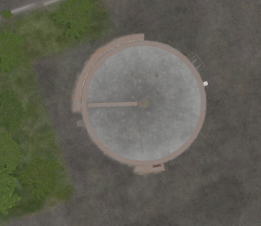
 | 500 IBS | 1000 IBS | 2000 IBS
1x Bomb
2x Bombs
4x Bombs
Gives ruins

Slide 10
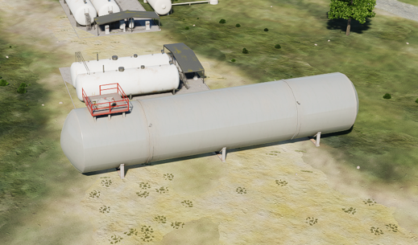
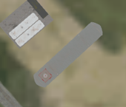
 | 500 IBS | 1000 IBS | 2000 IBS
1x Bomb
2x Bombs
4x Bombs
Gives ruins

Slide 11
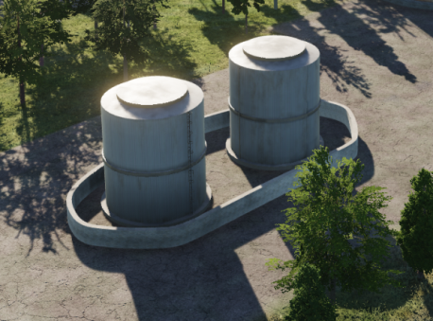
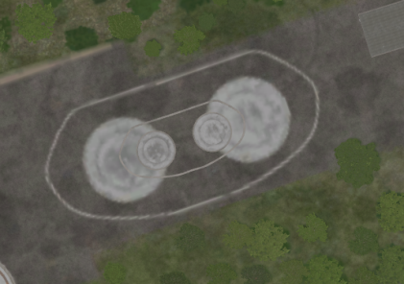
 | 500 IBS | 1000 IBS | 2000 IBS
1x Bomb
2x Bombs
4x Bombs
Gives ruins

Slide 12
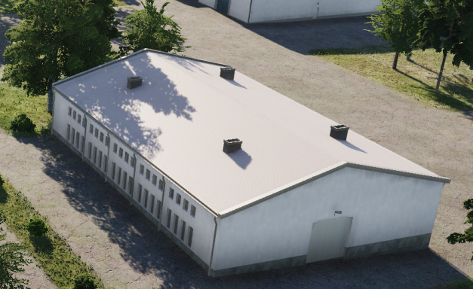
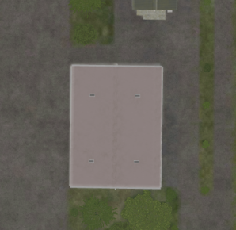
 | 500 IBS | 1000 IBS | 2000 IBS
1x Bomb
2x Bombs
4x Bombs
Gives ruins

Slide 13
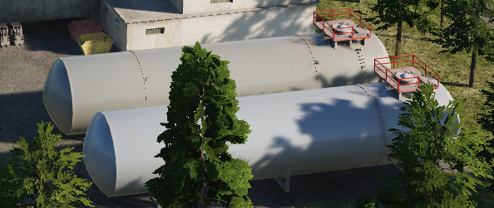
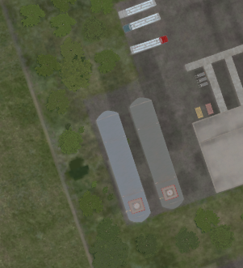
 | 500 IBS | 1000 IBS | 2000 IBS
1x Bomb
2x Bombs
4x Bombs
Gives ruins

Slide 14
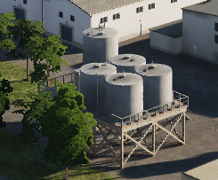
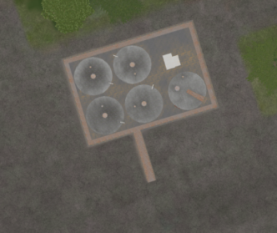
 | 500 IBS | 1000 IBS | 2000 IBS
1x Bomb
2x Bombs
4x Bombs
Gives ruins

Slide 15
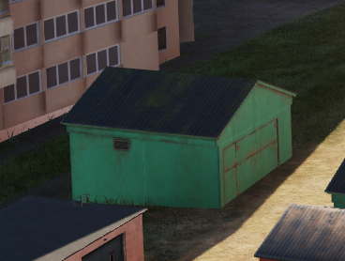
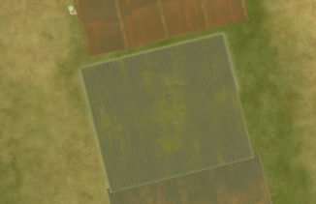
 | 500 IBS | 1000 IBS | 2000 IBS
1x Bomb
2x Bombs
4x Bombs
Gives ruins

Slide 16
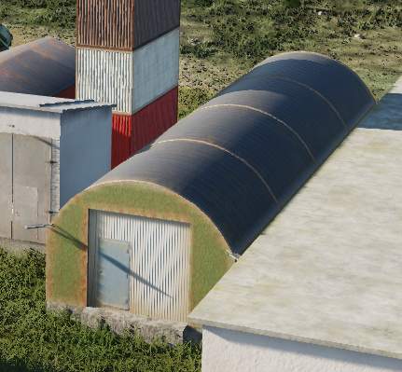
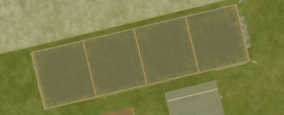
 | 500 IBS | 1000 IBS | 2000 IBS
1x Bomb
2x Bombs
4x Bombs
Gives ruins

Slide 17
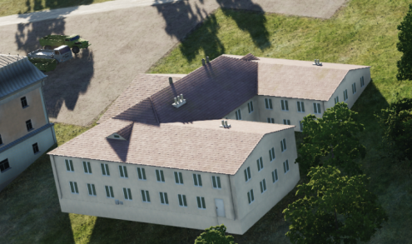
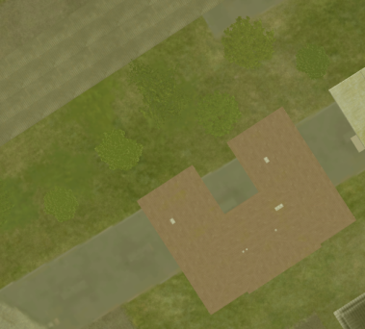
 | 500 IBS | 1000 IBS | 2000 IBS
1x Bomb
2x Bombs
4x Bombs
Gives ruins

Slide 18
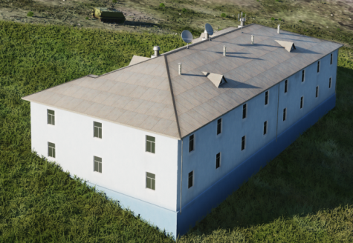
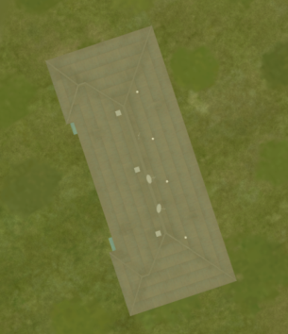
 | 500 IBS | 1000 IBS | 2000 IBS
1x Bomb
2x Bombs
4x Bombs
Gives ruins

Slide 19
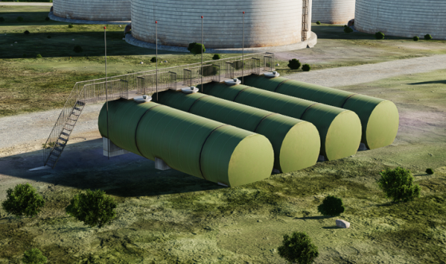
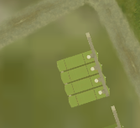
 | 500 IBS | 1000 IBS | 2000 IBS
1x Bomb
2x Bombs
4x Bombs
Gives ruins

Slide 20
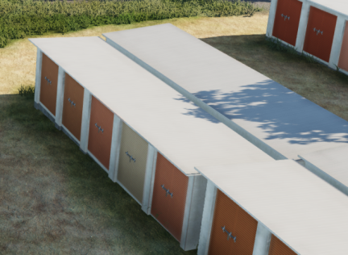
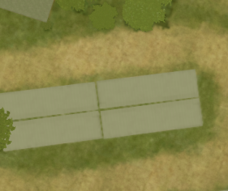
 | 500 IBS | 1000 IBS | 2000 IBS
1x Bomb
2x Bombs
4x Bombs
Gives ruins

Slide 21
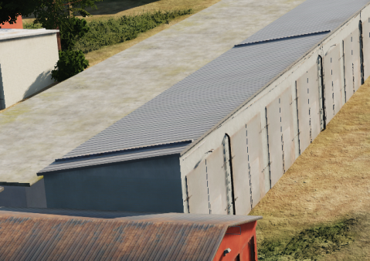
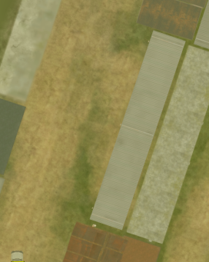
 | 500 IBS | 1000 IBS | 2000 IBS
1x Bomb
2x Bombs
4x Bombs
Gives ruins

Slide 22
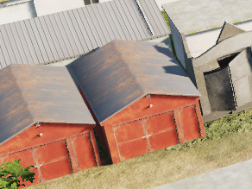
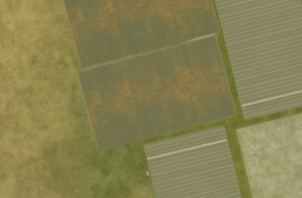
 | 500 IBS | 1000 IBS | 2000 IBS
1x Bomb | x
2x Bombs | x
4x Bombs
Gives ruins

Slide 23
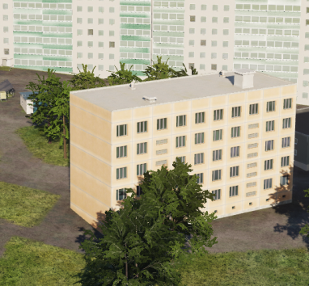
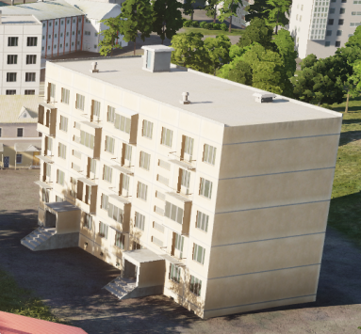
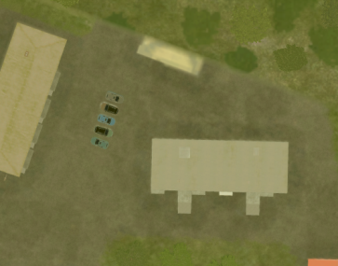
 | 500 IBS | 1000 IBS | 2000 IBS
1x Bomb
2x Bombs
4x Bombs
Gives ruins

Slide 24
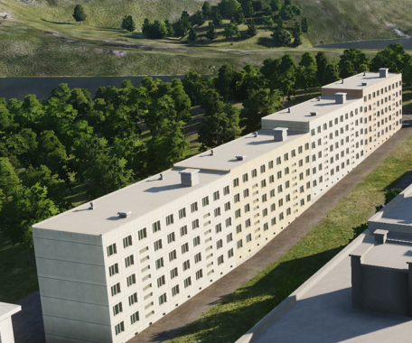
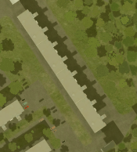
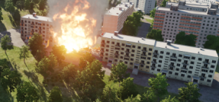
 | 500 IBS | 1000 IBS | 2000 IBS
1x Bomb
2x Bombs
4x Bombs
Gives ruins, can be destroyed in sections Bulding as shown have 4 sections, and individual sections can be destroyed and gives ruins.
In order to kill entire building, all 4 sections must be targeted.
Same building as to the left, but after individual section destroyed --->

Slide 25
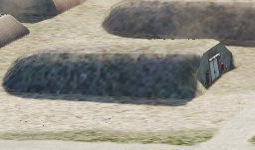
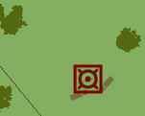


 | 500 IBS | 1000 IBS | 2000 IBS
1x Bomb
2x Bombs
4x Bombs
When destroyed, will be completely wiped from map, and will not give any ruins
But will give ”fireworks” /secondary explosions

Slide 26

 | 500 IBS | 1000 IBS | 2000 IBS
1x Bomb
2x Bombs
4x Bombs
When destroyed, will be completely wiped from map, and will not give any ruins
But will give ”fireworks” /secondary explosions

Slide 27


 | 500 IBS | 1000 IBS | 2000 IBS
1x Bomb
2x Bombs
4x Bombs
When destroyed, will be completely wiped from map, and will not give any ruins
But will give ”fireworks” /secondary explosions

Slide 28


 | 500 IBS | 1000 IBS | 2000 IBS
1x Bomb
2x Bombs
4x Bombs
When destroyed, will be completely wiped from map, and will not give any ruins

Slide 29


 | 500 IBS | 1000 IBS | 2000 IBS
1x Bomb
2x Bombs
4x Bombs
When destroyed, will be completely wiped from map, and will not give any ruins

Slide 30


 | 500 IBS | 1000 IBS | 2000 IBS
1x Bomb
2x Bombs
4x Bombs
When destroyed, will be completely wiped from map, and will not give any ruins

Slide 31


 | 500 IBS | 1000 IBS | 2000 IBS
1x Bomb
2x Bombs
4x Bombs
When destroyed, will be completely wiped from map, and will not give any ruins

Slide 32


 | 500 IBS | 1000 IBS | 2000 IBS
1x Bomb
2x Bombs
4x Bombs
When destroyed, will be completely wiped from map, and will not give any ruins

Slide 33


 | 500 IBS | 1000 IBS | 2000 IBS
1x Bomb
2x Bombs
4x Bombs
When destroyed, will be completely wiped from map, and will not give any ruins

Slide 34


 | 500 IBS | 1000 IBS | 2000 IBS
1x Bomb
2x Bombs
4x Bombs
When destroyed, will be completely wiped from map, and will not give any ruins

Slide 35


 | 500 IBS | 1000 IBS | 2000 IBS
1x Bomb
2x Bombs
4x Bombs
When destroyed, will be completely wiped from map, and will not give any ruins

Slide 36


 | 500 IBS | 1000 IBS | 2000 IBS
1x Bomb
2x Bombs
4x Bombs
When destroyed, will be completely wiped from map, and will not give any ruins

Slide 37


 | 500 IBS | 1000 IBS | 2000 IBS
1x Bomb
2x Bombs
4x Bombs
When destroyed, will be completely wiped from map, and will not give any ruins

Slide 38


 | 500 IBS | 1000 IBS | 2000 IBS
1x Bomb
2x Bombs
4x Bombs
When destroyed, will be completely wiped from map, and will not give any ruins

Slide 39


 | 500 IBS | 1000 IBS | 2000 IBS
1x Bomb
2x Bombs
4x Bombs
When destroyed, will be completely wiped from map, and will not give any ruins

Slide 40


 | 500 IBS | 1000 IBS | 2000 IBS
1x Bomb
2x Bombs
4x Bombs
When destroyed, will be completely wiped from map, and will not give any ruins

Slide 41


 | 500 IBS | 1000 IBS | 2000 IBS
1x Bomb
2x Bombs
4x Bombs
When destroyed, will be completely wiped from map, and will not give any ruins

Slide 42


 | 500 IBS | 1000 IBS | 2000 IBS
1x Bomb
2x Bombs
4x Bombs
When destroyed, will be completely wiped from map, and will not give any ruins

Slide 43


 | 500 IBS | 1000 IBS | 2000 IBS
1x Bomb
2x Bombs
4x Bombs
When destroyed, will be completely wiped from map, and will not give any ruins

Slide 44


 | 500 IBS | 1000 IBS | 2000 IBS
1x Bomb
2x Bombs
4x Bombs
When destroyed, will be completely wiped from map, and will not give any ruins

Slide 45


 | 500 IBS | 1000 IBS | 2000 IBS
1x Bomb
2x Bombs
4x Bombs
When destroyed, will be completely wiped from map, and will not give any ruins

Slide 46


 | 500 IBS | 1000 IBS | 2000 IBS
1x Bomb
2x Bombs
4x Bombs
When destroyed, will be completely wiped from map, and will not give any ruins

Slide 47


 | 500 IBS | 1000 IBS | 2000 IBS
1x Bomb
2x Bombs
4x Bombs
When destroyed, will be completely wiped from map, and will not give any ruins

Slide 48


 | 500 IBS | 1000 IBS | 2000 IBS
1x Bomb
2x Bombs
4x Bombs
When destroyed, will be completely wiped from map, and will not give any ruins

Slide 49


 | 500 IBS | 1000 IBS | 2000 IBS
1x Bomb
2x Bombs
4x Bombs
When destroyed, will be completely wiped from map, and will not give any ruins

Slide 50


 | 500 IBS | 1000 IBS | 2000 IBS
1x Bomb
2x Bombs
4x Bombs
When destroyed, will be completely wiped from map, and will not give any ruins

Slide 51


 | 500 IBS | 1000 IBS | 2000 IBS
1x Bomb
2x Bombs
4x Bombs
When destroyed, will be completely wiped from map, and will not give any ruins

Slide 52


 | 500 IBS | 1000 IBS | 2000 IBS
1x Bomb
2x Bombs
4x Bombs
When destroyed, will be completely wiped from map, and will not give any ruins

Slide 53


 | 500 IBS | 1000 IBS | 2000 IBS
1x Bomb
2x Bombs
4x Bombs
When destroyed, will be completely wiped from map, and will not give any ruins

Slide 54


 | 500 IBS | 1000 IBS | 2000 IBS
1x Bomb
2x Bombs
4x Bombs
When destroyed, will be completely wiped from map, and will not give any ruins

Slide 55


 | 500 IBS | 1000 IBS | 2000 IBS
1x Bomb
2x Bombs
4x Bombs
When destroyed, will be completely wiped from map, and will not give any ruins

Slide 56


 | 500 IBS | 1000 IBS | 2000 IBS
1x Bomb
2x Bombs
4x Bombs
When destroyed, will be completely wiped from map, and will not give any ruins

Slide 57


 | 500 IBS | 1000 IBS | 2000 IBS
1x Bomb
2x Bombs
4x Bombs
When destroyed, will be completely wiped from map, and will not give any ruins

Slide 58


 | 500 IBS | 1000 IBS | 2000 IBS
1x Bomb
2x Bombs
4x Bombs
Gives ruins

Slide 59


 | 500 IBS | 1000 IBS | 2000 IBS
1x Bomb
2x Bombs
4x Bombs
Gives ruins

Slide 60


 | 500 IBS | 1000 IBS | 2000 IBS
1x Bomb
2x Bombs
4x Bombs

Slide 61


 | 500 IBS | 1000 IBS | 2000 IBS
1x Bomb
2x Bombs
4x Bombs
Gives ruins

Slide 62


 | 500 IBS | 1000 IBS | 2000 IBS
1x Bomb
2x Bombs
4x Bombs
INDESTRUCTABLE

Slide 63


 | 500 IBS | 1000 IBS | 2000 IBS
1x Bomb
2x Bombs
4x Bombs
INDESTRUCTABLE

Slide 64


 | 500 IBS | 1000 IBS | 2000 IBS
1x Bomb
2x Bombs
4x Bombs
INDESTRUCTABLE

Slide 65


 | 500 IBS | 1000 IBS | 2000 IBS
1x Bomb
2x Bombs
4x Bombs
INDESTRUCTABLE

Slide 66


 | 500 IBS | 1000 IBS | 2000 IBS
1x Bomb
2x Bombs
4x Bombs
INDESTRUCTABLE

Slide 67


 | 500 IBS | 1000 IBS | 2000 IBS
1x Bomb
2x Bombs
4x Bombs
INDESTRUCTABLE

Slide 68


 | 500 IBS | 1000 IBS | 2000 IBS
1x Bomb
2x Bombs
4x Bombs
INDESTRUCTABLE

Slide 69


 | 500 IBS | 1000 IBS | 2000 IBS
1x Bomb
2x Bombs
4x Bombs
INDESTRUCTABLE

Slide 70


 | 500 IBS | 1000 IBS | 2000 IBS
1x Bomb
2x Bombs
4x Bombs
INDESTRUCTABLE

Slide 71


 | 500 IBS | 1000 IBS | 2000 IBS
1x Bomb
2x Bombs
4x Bombs
INDESTRUCTABLE

Slide 72


 | 500 IBS | 1000 IBS | 2000 IBS
1x Bomb
2x Bombs
4x Bombs
INDESTRUCTABLE

Slide 73


 | 500 IBS | 1000 IBS | 2000 IBS
1x Bomb | x
2x Bombs | x
4x Bombs | x
INDESTRUCTABLE

Slide 74


 | 500 IBS | 1000 IBS | 2000 IBS
1x Bomb
2x Bombs
4x Bombs
INDESTRUCTABLE

Slide 75


 | 500 IBS | 1000 IBS | 2000 IBS
1x Bomb
2x Bombs
4x Bombs
INDESTRUCTABLE

Slide 76


 | 500 IBS | 1000 IBS | 2000 IBS
1x Bomb
2x Bombs
4x Bombs
INDESTRUCTABLE

Slide 77


 | 500 IBS | 1000 IBS | 2000 IBS
1x Bomb
2x Bombs
4x Bombs
Gives ruins

Slide 78


 | 500 IBS | 1000 IBS | 2000 IBS
1x Bomb
2x Bombs
4x Bombs
Gives ruins

Slide 79


 | 500 IBS | 1000 IBS | 2000 IBS
1x Bomb
2x Bombs
4x Bombs
Gives ruins

Slide 80


 | 500 IBS | 1000 IBS | 2000 IBS
1x Bomb
2x Bombs
4x Bombs
Gives ruins

Slide 81


 | 500 IBS | 1000 IBS | 2000 IBS
1x Bomb
2x Bombs
4x Bombs
Gives ruins

Slide 82


 | 500 IBS | 1000 IBS | 2000 IBS
1x Bomb
2x Bombs
4x Bombs
Gives ruins

Slide 83


 | 500 IBS | 1000 IBS | 2000 IBS
1x Bomb
2x Bombs
4x Bombs
Gives ruins

Slide 84


 | 500 IBS | 1000 IBS | 2000 IBS
1x Bomb
2x Bombs
4x Bombs
Gives ruins

Slide 85

 | 500 IBS | 1000 IBS | 2000 IBS
1x Bomb
2x Bombs
4x Bombs
Gives ruins

Slide 86
UNDER TESTING AFTER THIS

Slide 87
 | 500 IBS | 1000 IBS | 2000 IBS
1x Bomb
2x Bombs
4x Bombs

Slide 88
UNVERIFIED after this

Slide 89

 | 500 IBS | 1000 IBS | 2000 IBS
1x Bomb
2x Bombs
4x Bombs

Slide 90


 | 500 IBS | 1000 IBS | 2000 IBS
1x Bomb
2x Bombs
4x Bombs
 | 500 IBS | 1000 IBS | 2000 IBS
1x Bomb
2x Bombs
4x Bombs

Slide 91


 | 500 IBS | 1000 IBS | 2000 IBS
1x Bomb
2x Bombs
4x Bombs
Gives ruins

Slide 92



 | 500 IBS | 1000 IBS | 2000 IBS
1x Bomb
2x Bombs
4x Bombs
Gives ruins (suggest 90 degree impact angle in tgt folder, as the destroyed bulding have a hole in the roof

Slide 93


 | 500 IBS | 1000 IBS | 2000 IBS
1x Bomb
2x Bombs
4x Bombs
Gives ruins

Slide 94

 | 500 IBS | 1000 IBS | 2000 IBS
1x Bomb
2x Bombs
4x Bombs

Slide 95


 | 500 IBS | 1000 IBS | 2000 IBS
1x Bomb
2x Bombs
4x Bombs

Slide 96

 | 500 IBS | 1000 IBS | 2000 IBS
1x Bomb
2x Bombs
4x Bombs

Slide 97

 | 500 IBS | 1000 IBS | 2000 IBS
1x Bomb
2x Bombs
4x Bombs

Slide 98

 | 500 IBS | 1000 IBS | 2000 IBS
1x Bomb
2x Bombs
4x Bombs

Slide 99

 | 500 IBS | 1000 IBS | 2000 IBS
1x Bomb
2x Bombs
4x Bombs

Slide 100

 | 500 IBS | 1000 IBS | 2000 IBS
1x Bomb
2x Bombs
4x Bombs
COMMENT: AFTER TESTING IT SEEMS NOT TO BE POSSIBLE TO DESTROY (2024-12-29)
NOTE: Also destructable with 20mm cannon

